Slide 1
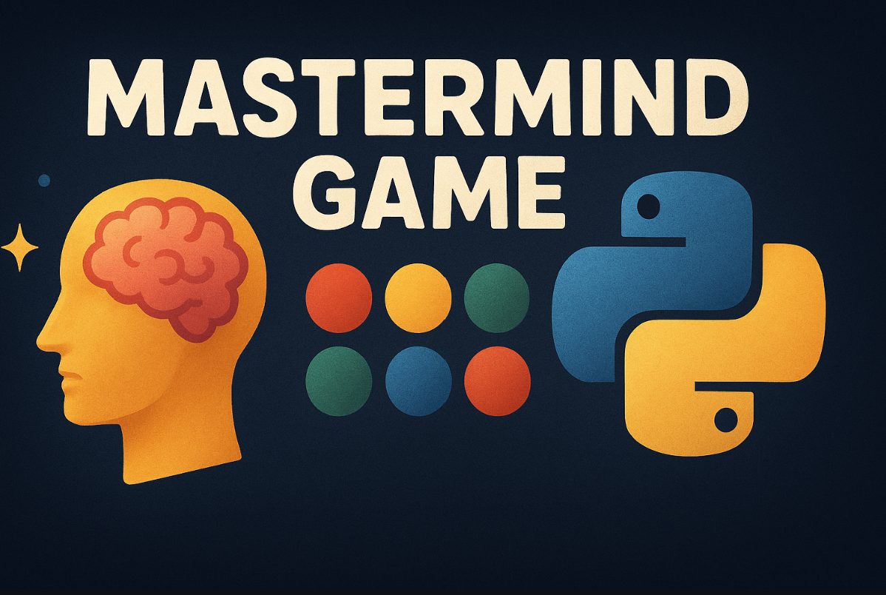
Mastermind Game
Software Engineering Project Team
Markus Maximus ( Scrum Master)
Laurenz Stelzl (Product Owner)
Mohammadali Vaezi – Developer and tester
Adnan Eminovic – Developer
Seyed Hossein Meymandi Nezhad – Developer
GitHub: https://github.com/alivaezii/mastermindgame
Wiki: https://github.com/alivaezii/mastermindgame/wiki

Slide 2
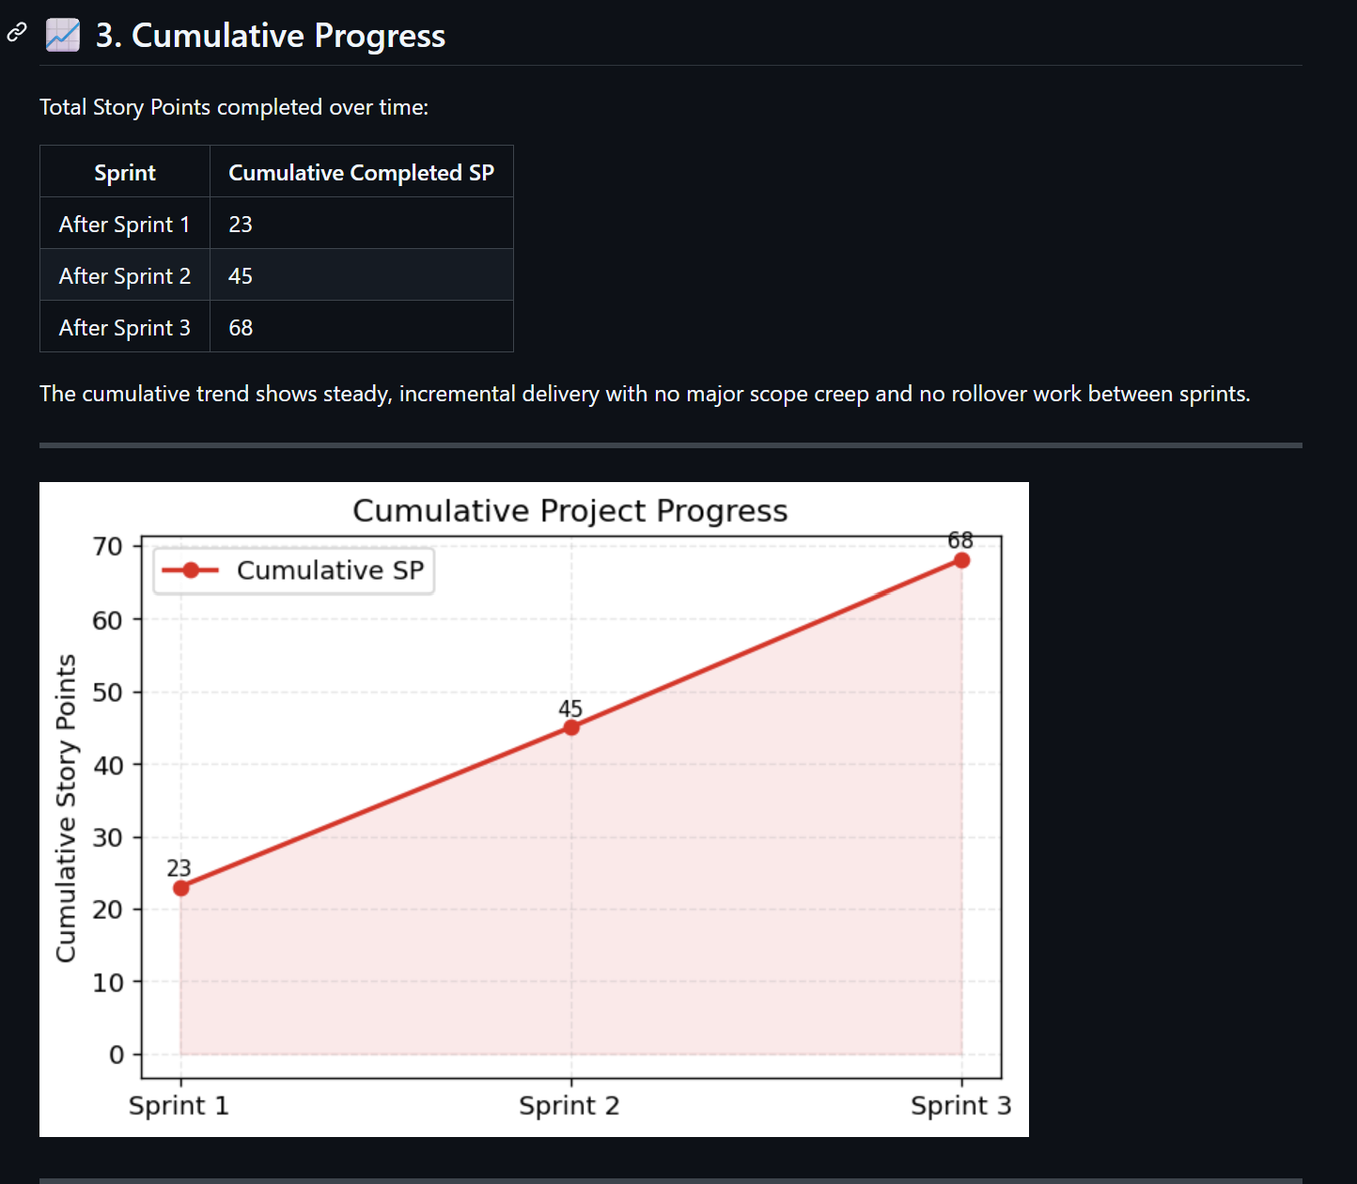
Project Overview & Product Backlog
The goal of this project is to design and implement a digital version of the Mastermind game that follows Agile principles.
The project includes a game engine, a CLI, a GUI prototype, automated tests, CI/CD, and complete documentation.
GitHub Wiki: Product Backlog: https://github.com/alivaezii/mastermindgame/wiki/Product-Backlog

Slide 3
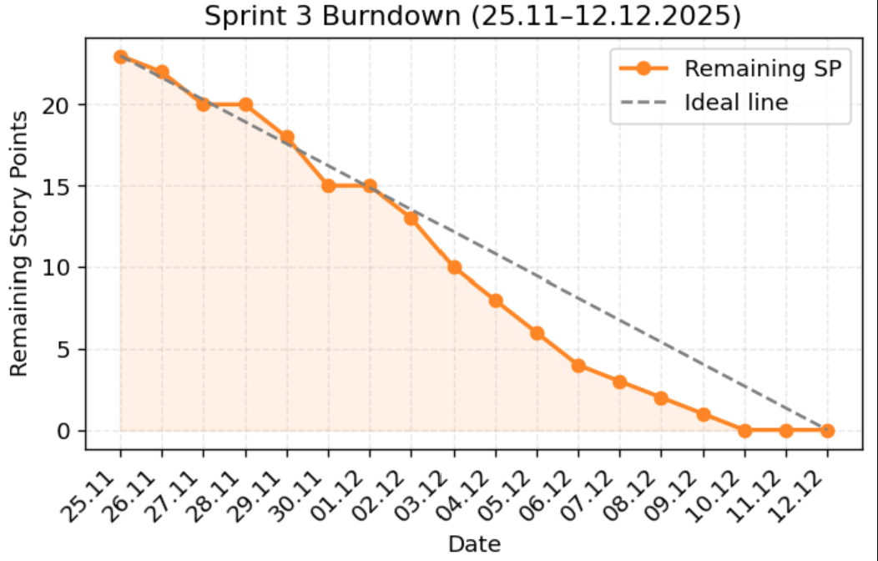
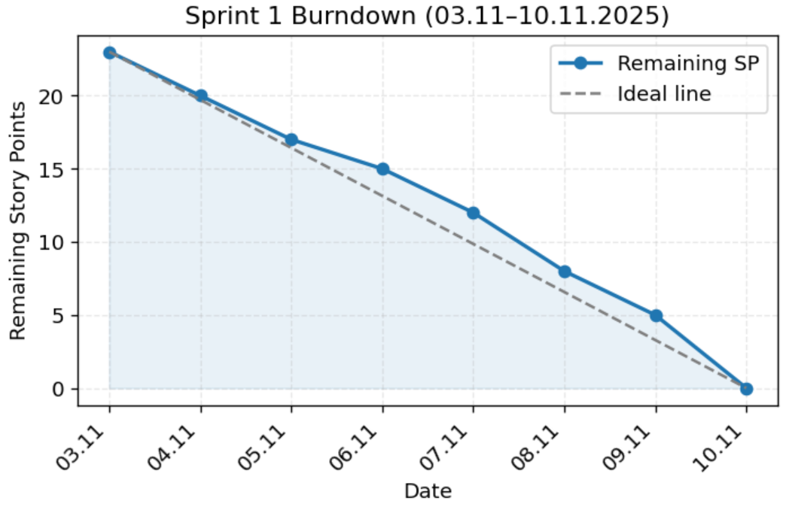
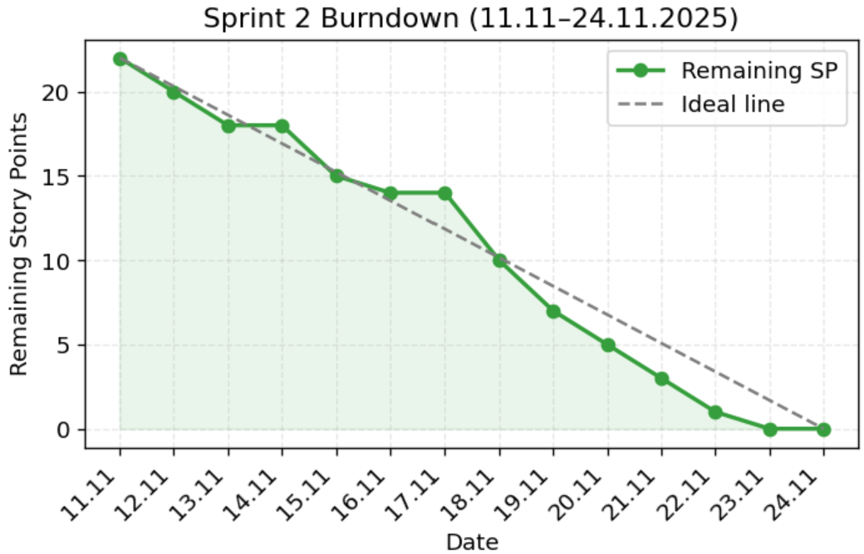
Scrum Process & Team Coordination
Scrum framework with three sprints
Sprint Planning, Review, Retrospective
Online ceremonies due to exam schedule
Technology decision: Java → Python
Story Points estimation using Planning Poker
Full documentation in Wiki (Sprints & Retros)
https://github.com/alivaezii/mastermindgame/wiki/Agile-Metrics
https://github.com/alivaezii/mastermindgame/wiki/Sprint-Backlogs

Slide 4
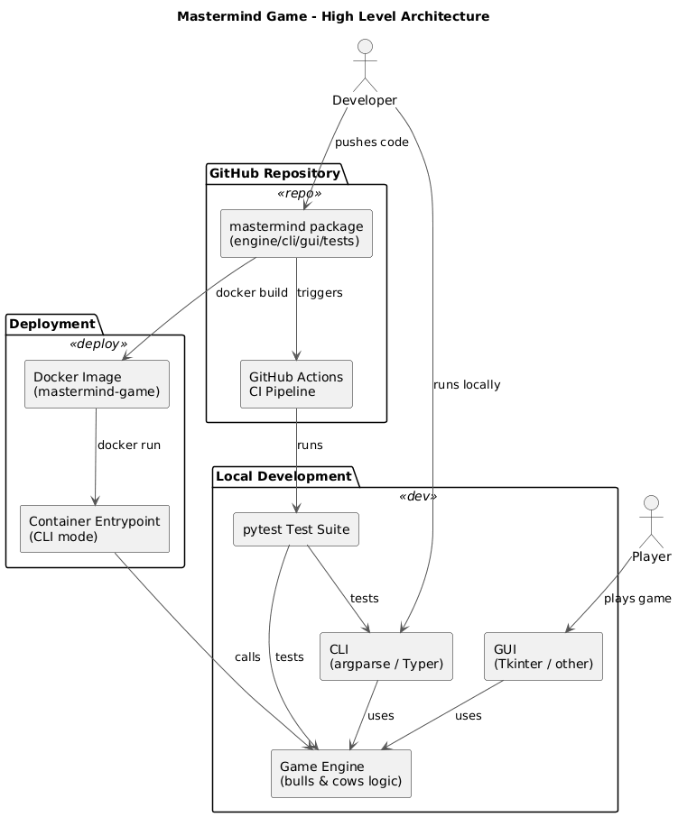
System Architecture & Design Decisions
Modular architecture with clear separation of concerns
Core game logic independent from UI and infrastructure
Designed for testability, extensibility, and maintainability
Main Architectural Modules
Game Engine (core logic)
CLI Interface
GUI Prototype Test Suite
CI/CD & Docker Infrastructure
Relation to Course Content
Layered architecture
Model–View separation
Use of basic design patterns

Slide 5
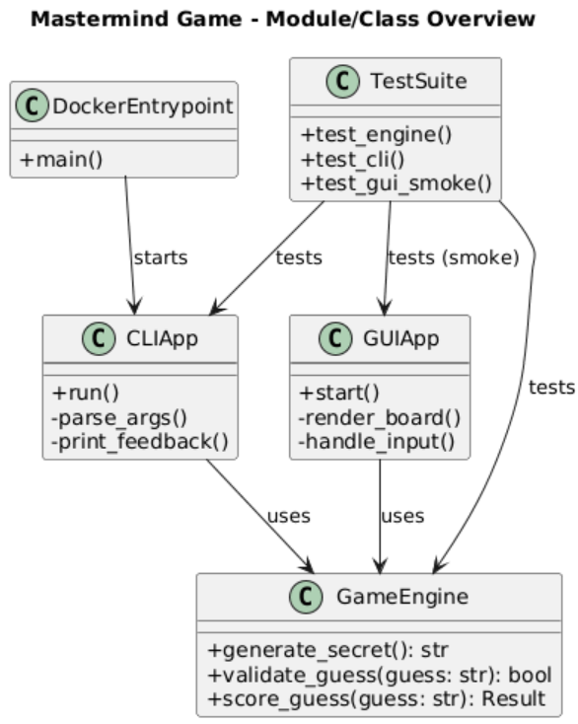
Design Patterns Used
Applied Design Patterns
Strategy-like behavior for rules configuration
Factory-style logic for secret generation
Single Responsibility Principle across modules
Why Patterns Were Useful
Reduced coupling between components
Easier refactoring and testing
Clear mapping to theoretical concepts from lectures
https://github.com/alivaezii/mastermindgame/wiki/Architecture-Overview

Slide 6
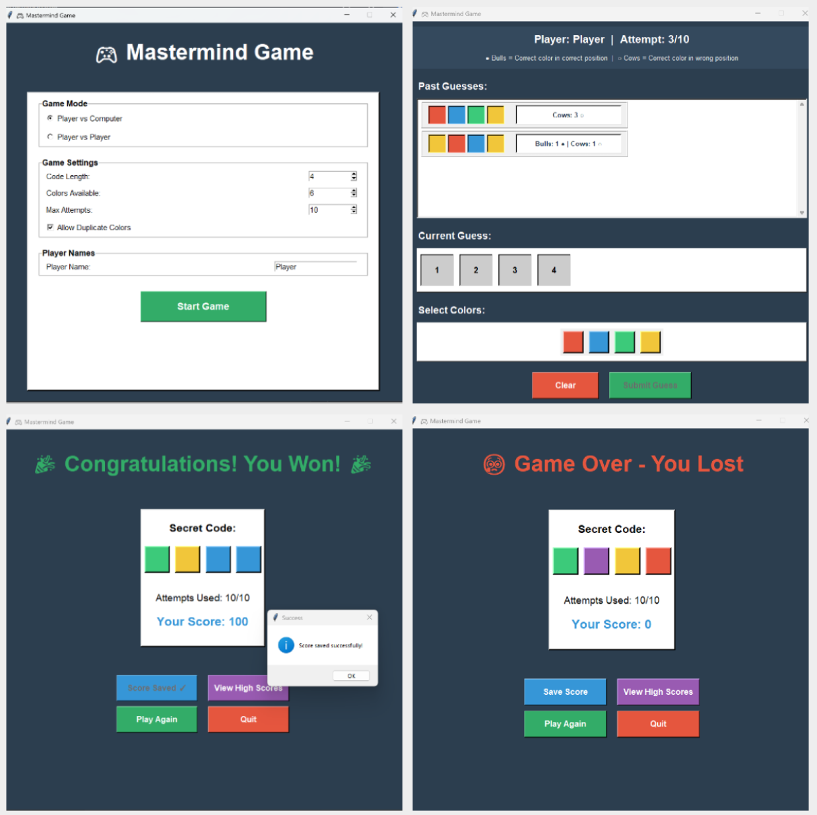
Refactoring & Architectural Evolution
Refactoring Decisions
Initial Java-based approach replaced by Python
Refactoring driven by complexity and maintainability
Continuous cleanup during Sprint 2
Reasons for Refactoring
Improve readability and structure
Reduce unnecessary complexity
Support faster development and testing

Slide 7
KPI Metrics
Area | Metric | Exact Value | Interpretation | Java / IntelliJ Equivalent
Version Control | Total commits | 92 | Continuous, incremental development | Git
CI Stability | CI jobs | 2 / 2 successful | Stable automated pipeline | Jenkins / GitHub Actions
Runtime | Python versions tested | 3.10, 3.11 | Cross-version compatibility | Multi-JDK CI
Testing | Tests passed | 68 / 68 (100%) | All tests green | JUnit 5
Testing | Test execution time | ≈ 0.35 s | Fast feedback loop | Surefire
Coverage | Line coverage (core+CLI) | 95% | High test effectiveness | JaCoCo
Static Quality | Lint issues | 0 | Clean, consistent code | Checkstyle / IDE inspections
Static Quality | Type errors | 0 | Strong type safety enforced | Java compiler checks
Documentation | Doc coverage | 92.6% | Well-documented code | JavaDoc rules
Complexity | Worst cyclomatic complexity | C (16) | One refactoring candidate | SonarQube
Code Size | Core source LOC | 2054 | Main application logic | LOC (IntelliJ Stats)
Code Size | Test LOC | 878 | Dedicated test suite | Test sources
Code Size | Total LOC | 2932 | Medium-sized student project | —
Quality Ratio | Test / Core ratio | 0.43 : 1 | Balanced testing effort | Test/Core ratio
The metrics show good quality: high coverage, clean code, no type or lint errors, and controlled complexity.

Slide 8
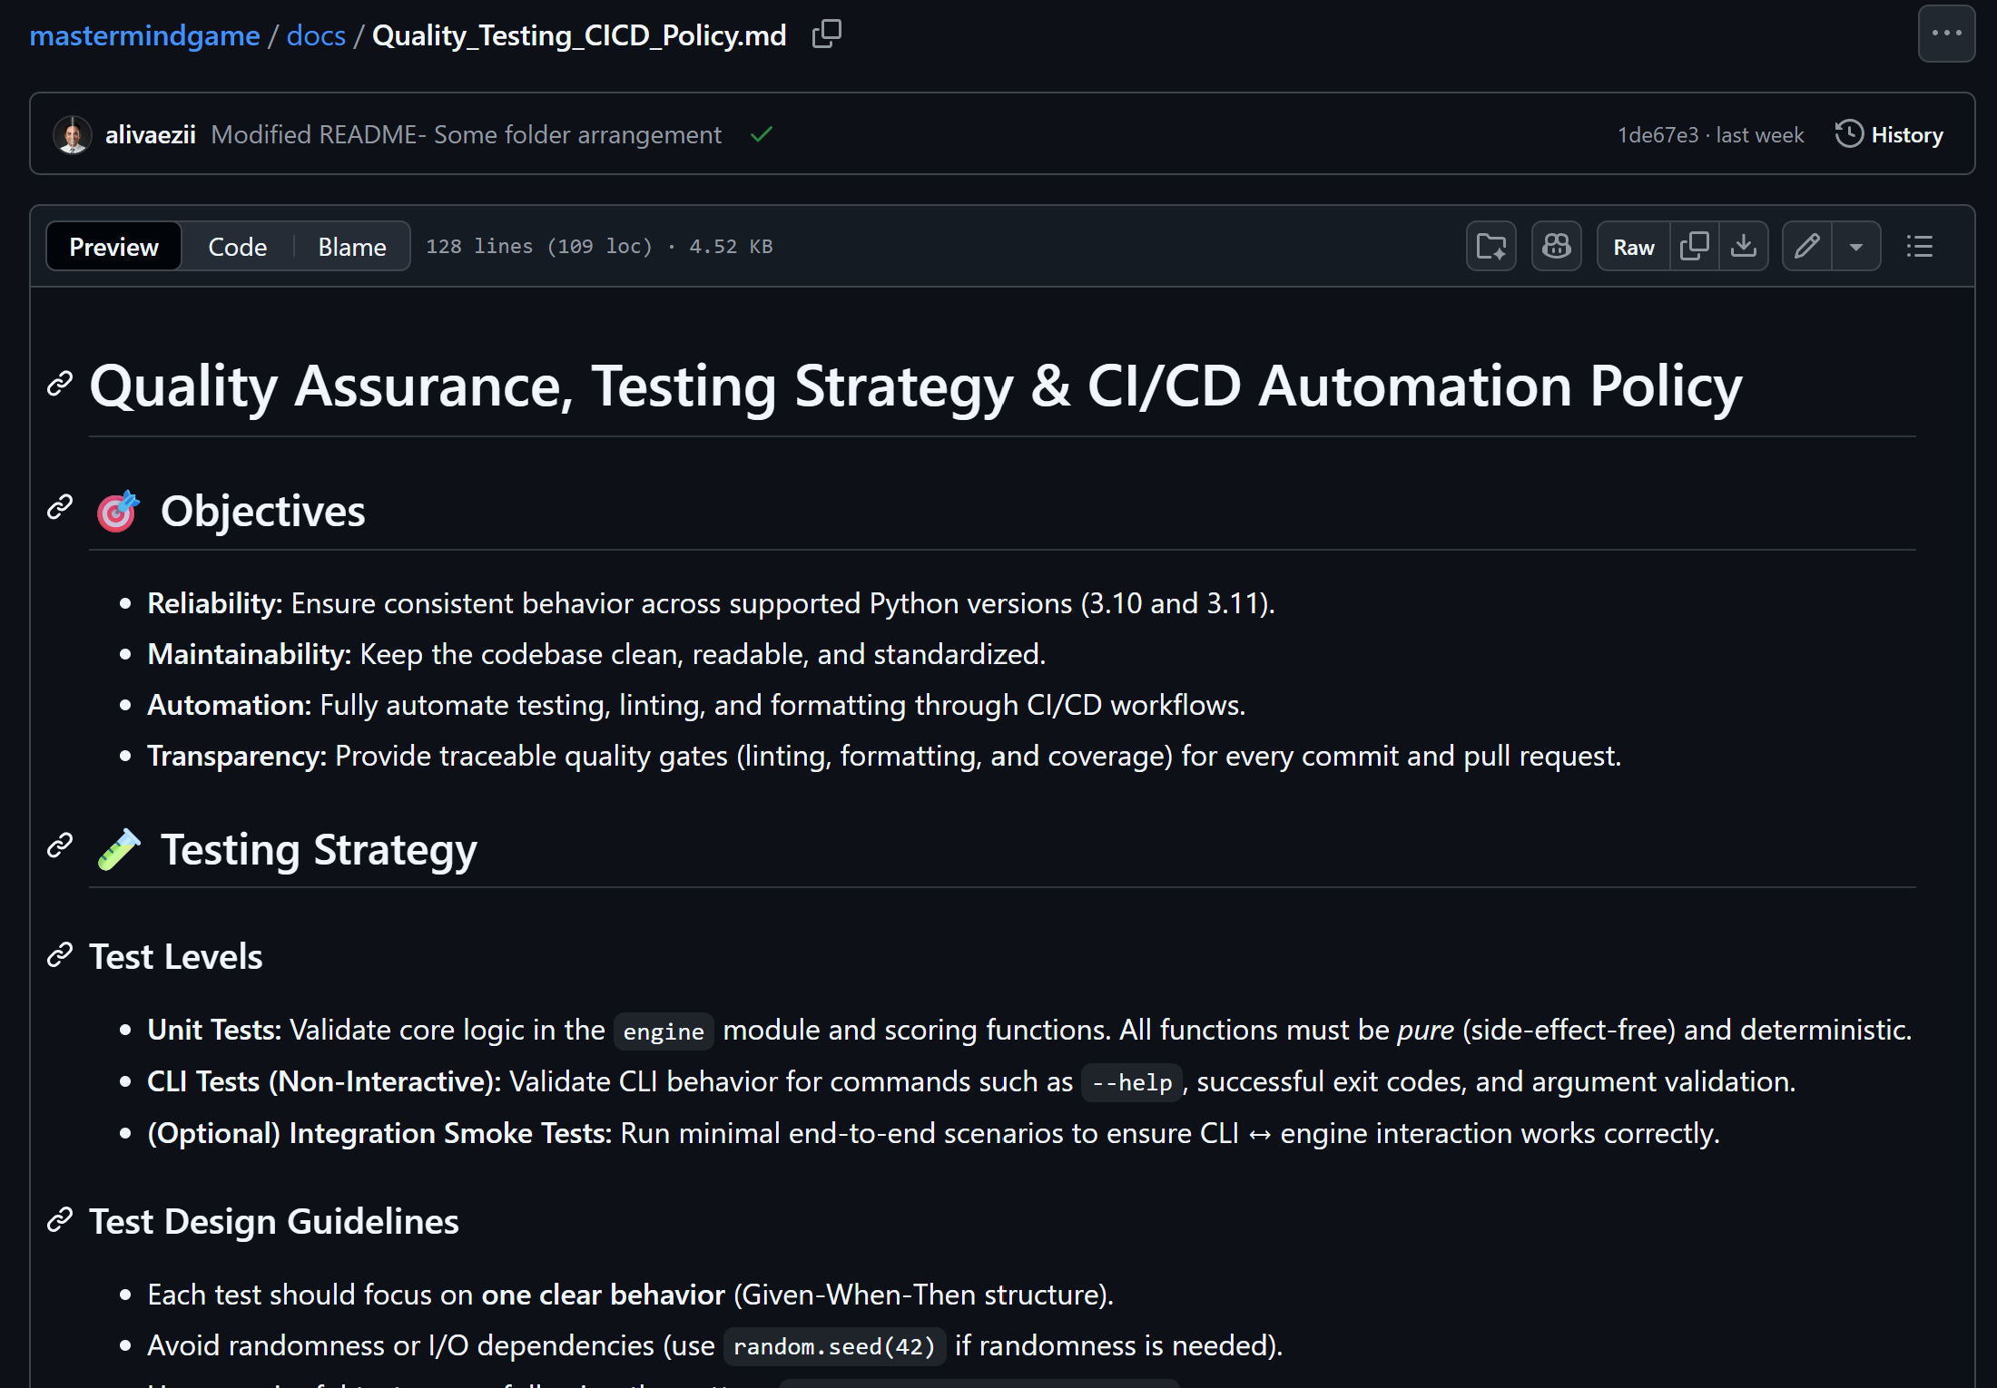
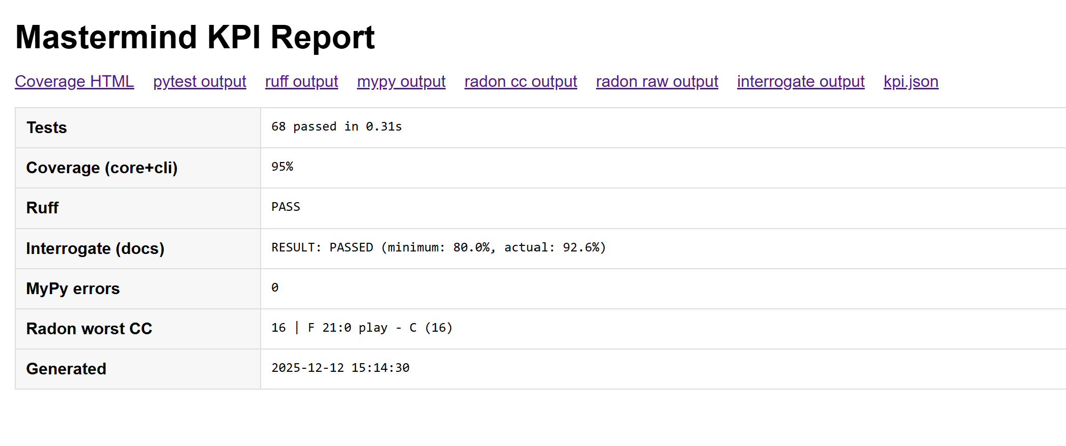
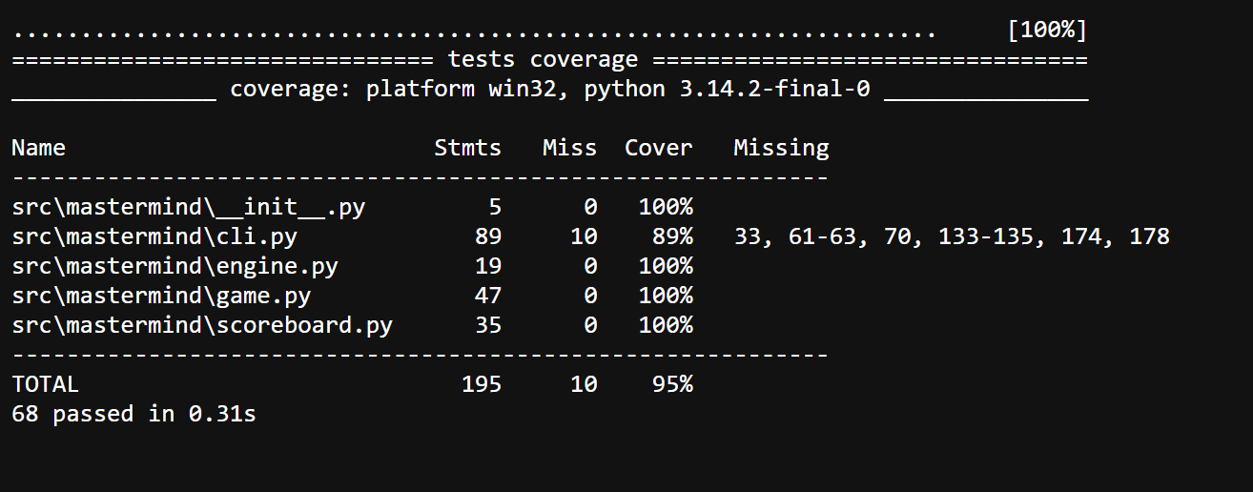

Slide 9
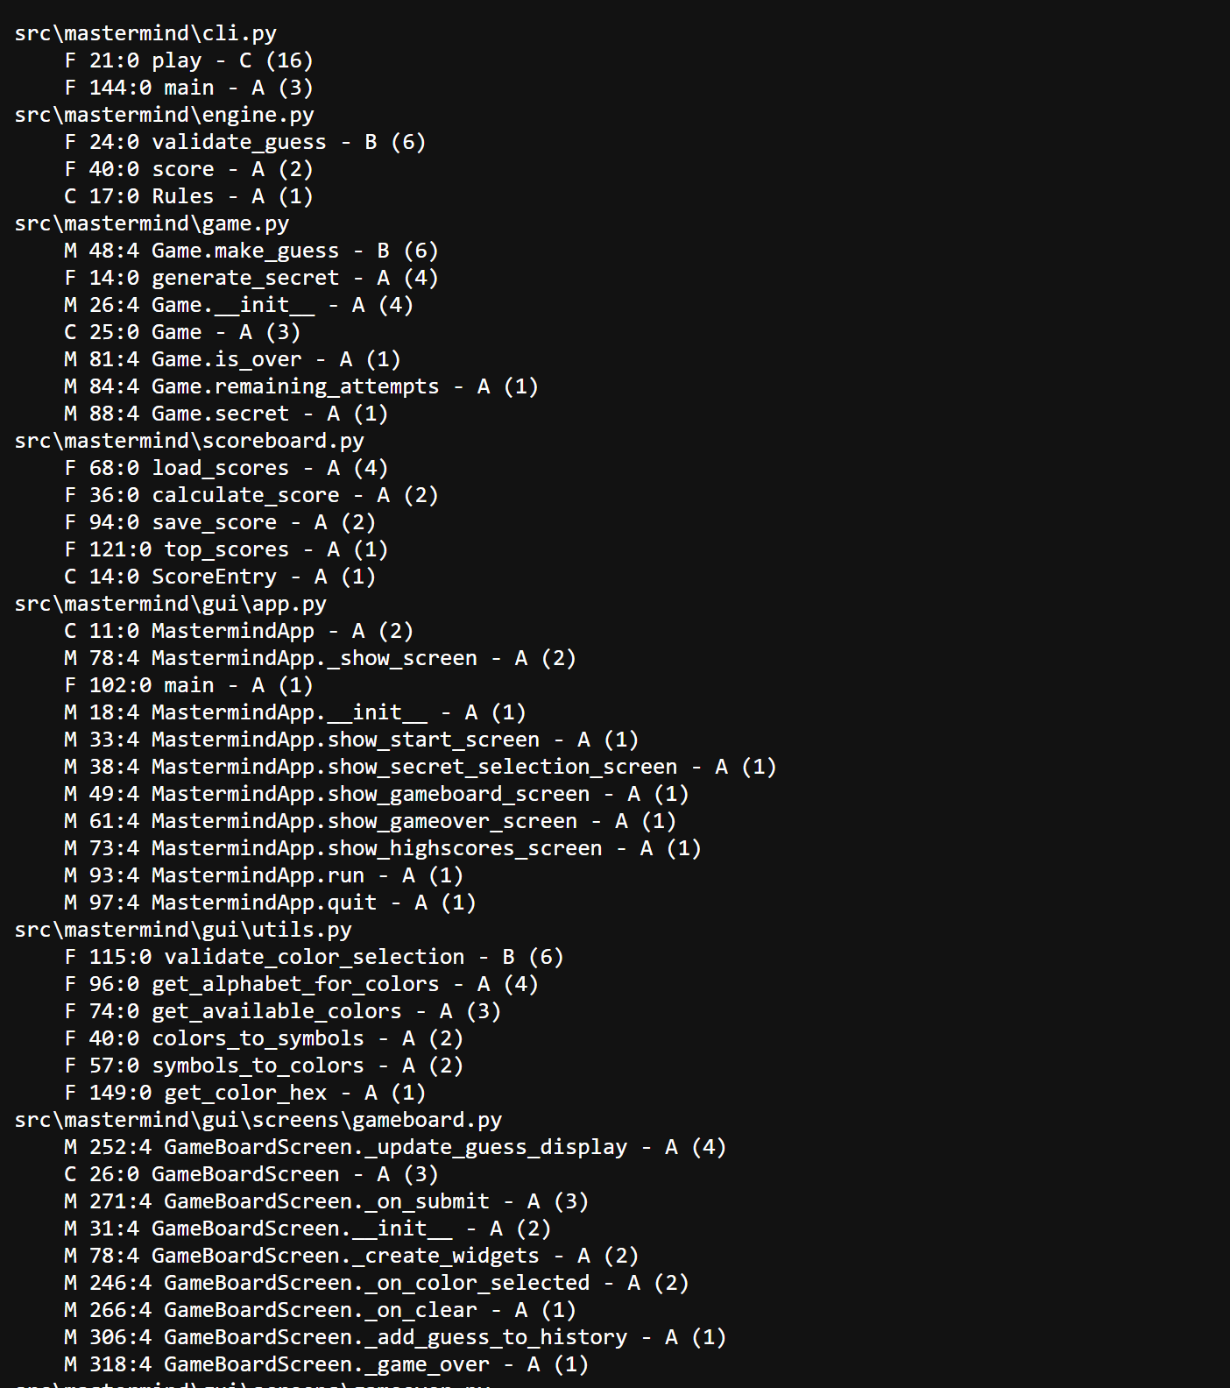
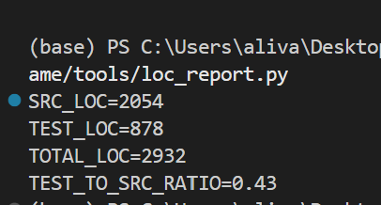
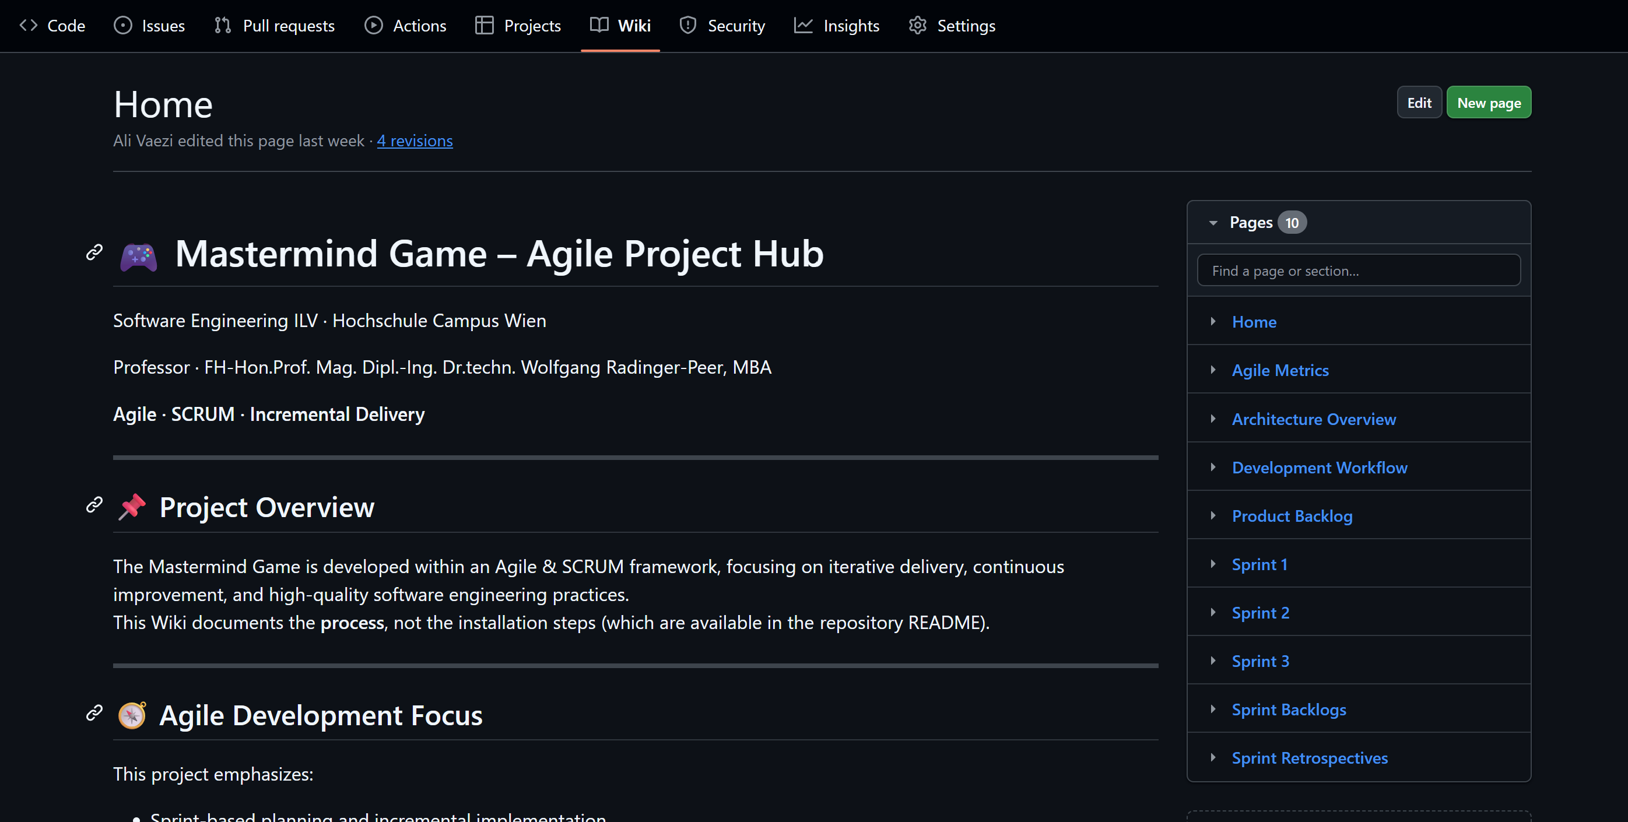

Slide 10
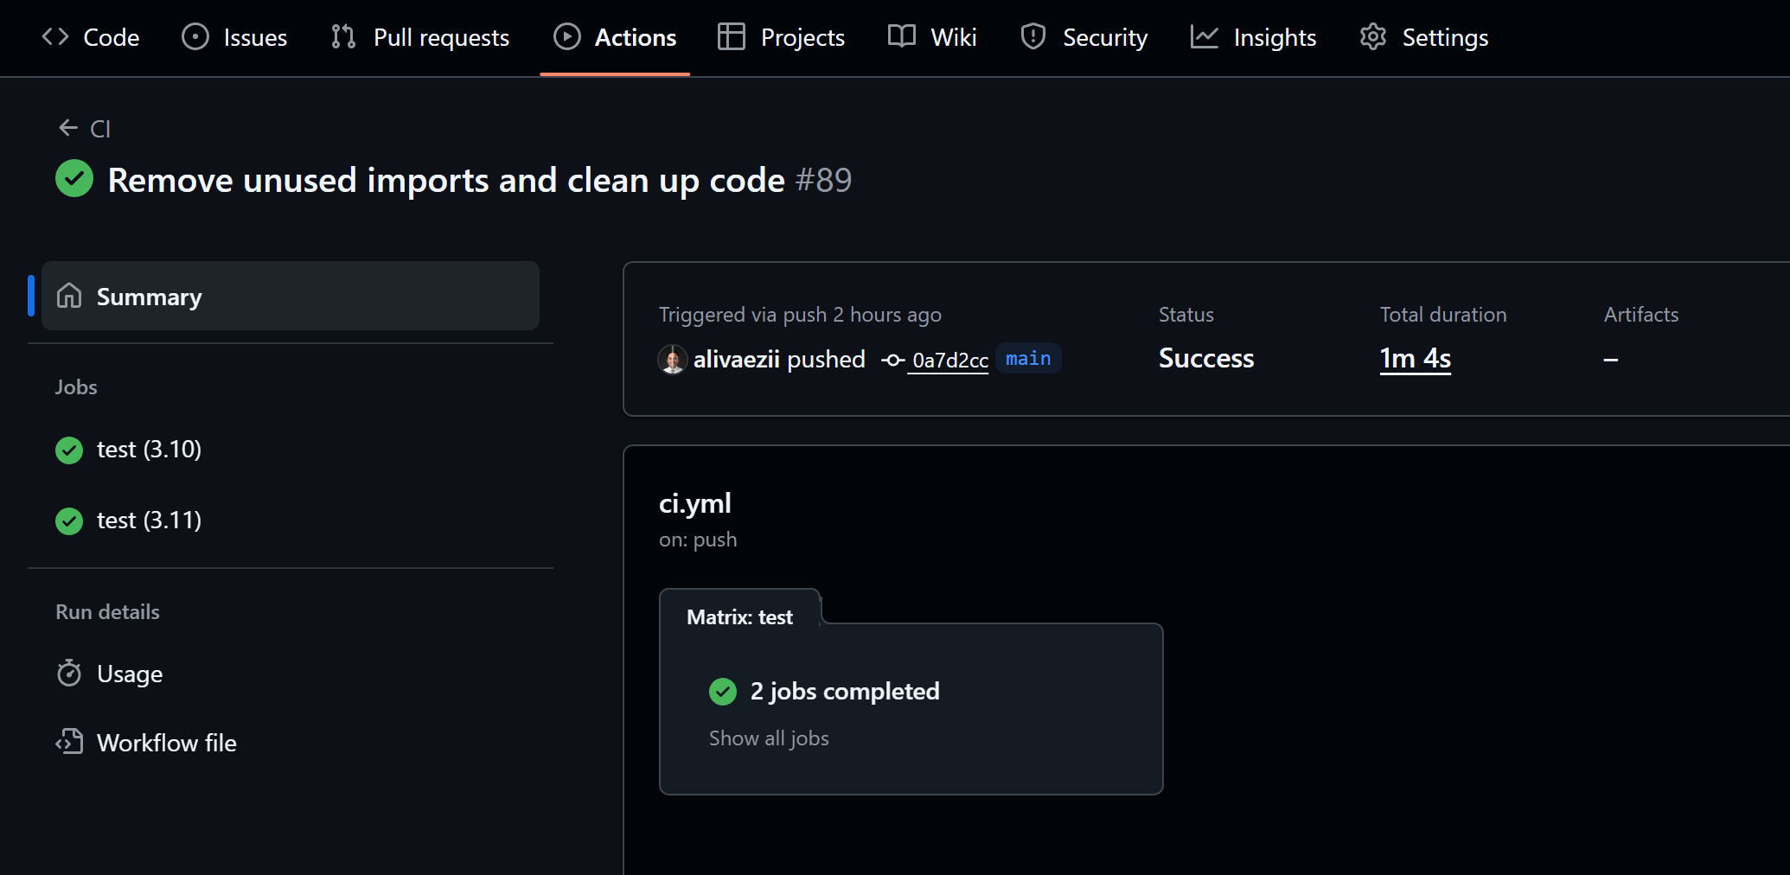
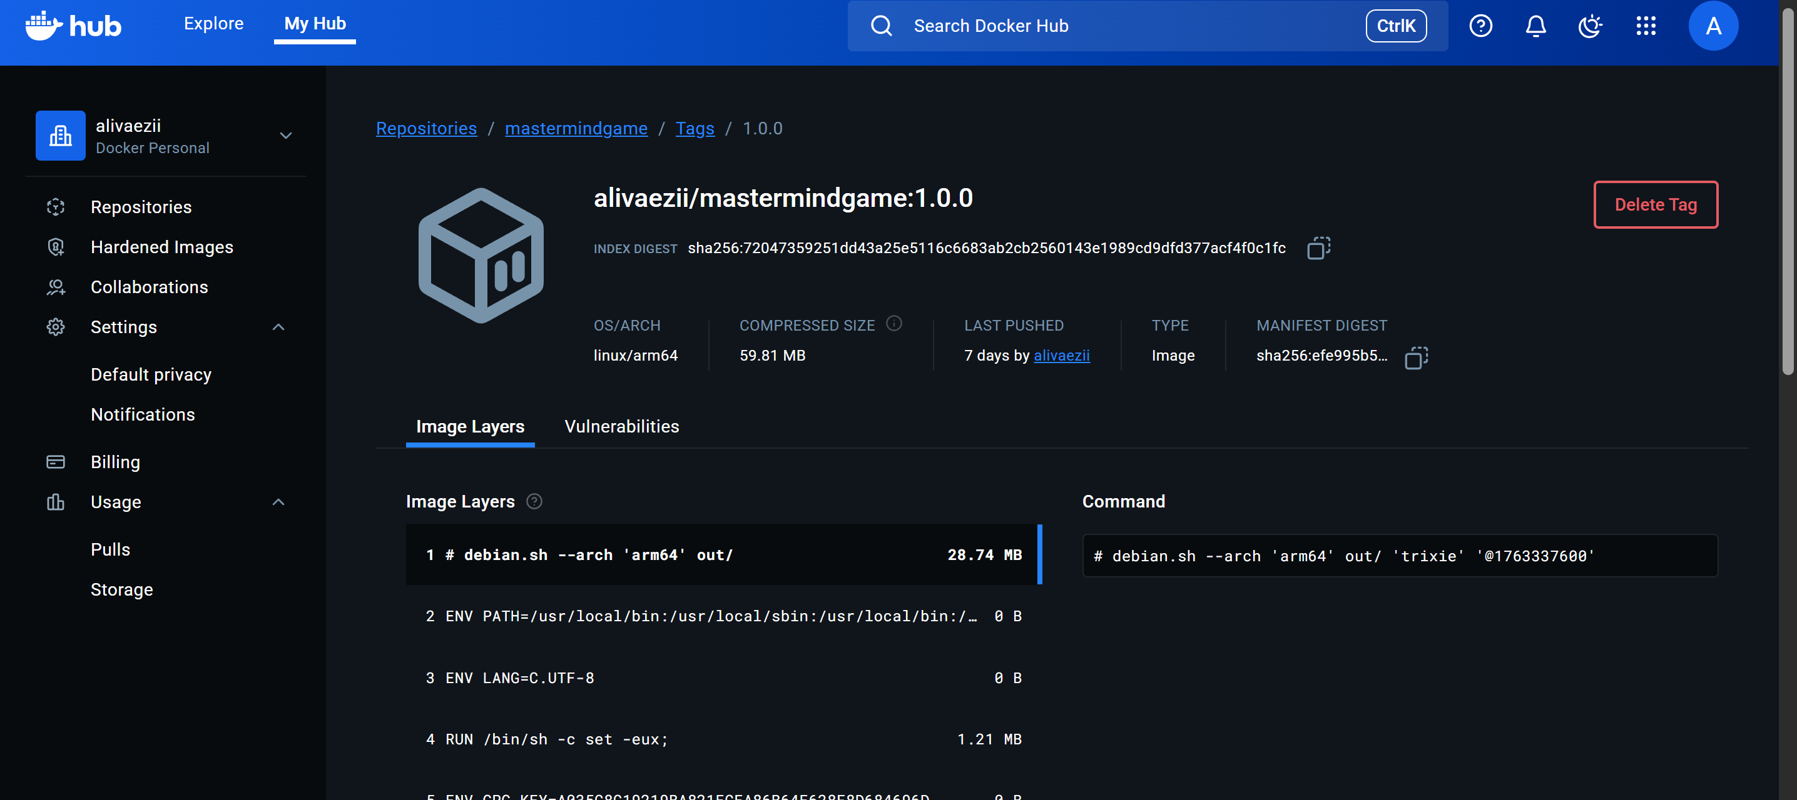
CI/CD & Docker: Automated Quality & Delivery
CI/CD (GitHub Actions)
Automated checks on every Pull Request
Linting, formatting, and tests executed automatically
Only green builds can be merged into main
Docker
Reproducible CLI runtime
No local setup required
Same behavior on all machines

